Slide 1
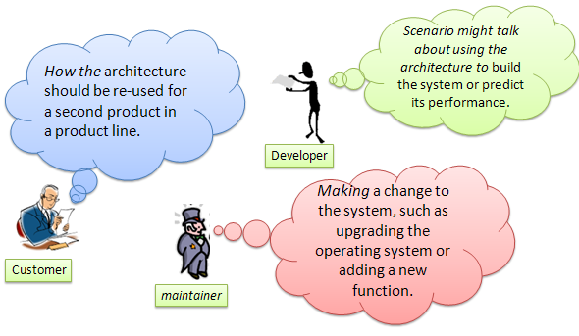
SWEN-755: Software Architecture
Architectural Tradeoff Analysis Method
(ATAM)
Recommended Reading: Ch 21 (Software Architecture In Practice, 3rd Ed)
Images from: http://blog.colossaltechnologies.com/?m=200811

Slide 2
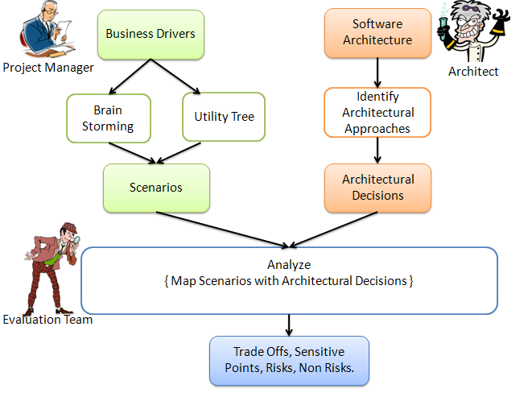
The ATAM
The ATAM
Architectural Tradeoff Analysis Method (ATAM)
Images from: http://blog.colossaltechnologies.com/?m=200811

Slide 3

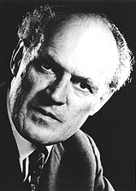
The ATAM
A side comment...
Gifted aircraft designer Willy Messerschmitt stated that:
“You can have any combination of features the Air Ministry desires, so long as you do not also require that the resulting airplane fly.”
Notes:
What does this mean? There will be tradeoffs if you really want a functioning system in the real world.

Slide 4

The ATAM
Conversely...
In Alice in Wonderland, Alice encounters
the Cheshire Cat and asks for directions.
The cat responds that it depends upon
where she wishes to go.
Alice says she doesn't know, whereupon
the cat tells her it doesn't matter which
way she walks.
So, if the sponsor of a system cannot tell you what any of the
quality goals are for the system, then any architecture will do.

Slide 5
The ATAM
The ATAM: Purpose
Designed to ask the following questions:
Is this architecture suitable for the system for which it was designed?
Which of two or more competing architectures is the most suitable one for the system at hand?
Can this system be built using the resources at hand: the staff, the budget, the legacy software (if any), and the time allotted before delivery, i.e. is it buildable?
Designed so that evaluators do not yet need to be familiar with the architecture or business goals, the system does not yet need to be constructed, and there may be a large number of stakeholders.
Notes:
Resources at hand can be constraints in some cases

Slide 6
The ATAM
The ATAM: Outcomes
An architectural evaluation will tell you that the architecture has been found suitable with respect to one set of goals and problematic with respect to another set of goals.
Sometimes the goals will be in conflict with each other, or at the very least, some goals will be more important than other ones.
Need to decide whether you can live with the architecture, strengthen its weaknesses, or start over.
An architecture evaluation doesn't tell you "yes" or "no," "good" or "bad," or "6.75 out of 10." It tells you where you are at risk.

Slide 7
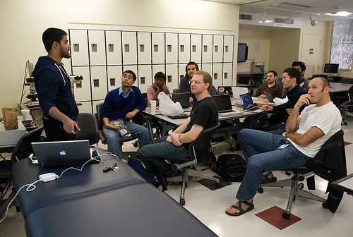
The ATAM
The ATAM: Participants
Evaluation team – external to the project being evaluated
Project decision makers – architect and the people who speak for the project (or have power to make changes)
Project stakeholders – people who have a vested interest in the architecture performing as advertised;
Articulate specific QA goals that the architecture should meet to be considered successful
Notes:
- eval team: usually 3 to 5 people, can work for the same organization or be outside consultants, need to be competent and unbiased
- decision makers: usually include project manager and may include the paying customer
- stakeholders: include devs, testers, integrators, maintainers, performance engineers, users, and builders of systems that must interact with the system being built; for a large enterprise-critical architecture, you can expect about 12-15 stakeholders

Slide 8
The ATAM
The ATAM: Outputs
A concise presentation of the architecture (PowerPoint presentation, up to one hour).
Articulation of the business goals.
Quality attribute requirements stated in terms of a collection of prioritized scenarios.
A set of risks and nonrisks.
A risk is an architectural decision that may lead to undesirable consequences.
A nonrisk is a safe architectural decision.
A set of risk themes.
Mapping of architectural decisions to quality requirements (form a rationale for decisions).
A set of identified sensitivity and tradeoff points.
Notes:
Undesirable consequences: from pov of the stated QA requirements.
Identified risks form the basis for an architectural risk mitigation plan.
Risk themes: identify systematic weaknesses in the architecture or the architecture process/team.

Slide 9
The ATAM
The ATAM: Phases
Phase 0: “Partnership and Preparation”
Informal meetings to plan for implementing the ATAM
Plan logistics and participants
Phase 1: Evaluation team meets with project decision makers to gather information
Steps 1-6
Phase 2: Stakeholders join proceeding to continue analysis
Steps 7-9
Phase 3: Follow-up
Final written report

Slide 10
The ATAM-Phase 1
Step 1: Present ATAM
Need to train people about the process.
Answer questions.
An external ATAM evaluation will cost a company $70K-$80K+.
There may be some reservations with respect to reviewing the architecture and perhaps undergoing changes.
You can apply the same ATAM steps on your own projects.

Slide 11
The ATAM-Phase 1
Step 2: Present Business Drivers
Project manager needs to present a system overview from the business perspective.
The system’s most important functions.
Any relevant technical, managerial, economic, or political constraints.
The business goals and context as they relate to the project.
The major stakeholders.
The architectural drivers (i.e. the major quality attribute goals that shape the architecture).

Slide 12
The ATAM-Phase 1
Step 2: Examples – MTS requirements
The Mechatronics Traceability System (MTS)
Overview: In mechatronics systems, elements of design are often modeled using a variety of tools and notations. They have separate views, but interact to produce the overall system behavior. Therefore, a change to one part can have impacts on other parts. The MTS captures dependencies and associations as trace links to support evaluations of proposed changes.
Example requirements include:
The MTS shall generate trace links automatically upon demand.
MTS shall enable traceability between data in heterogenous case tools.
The system needs to support 1000 simultaneous trace queries.
Notes:
Everyone starts a document where they note the below discussion down.
Class participation:
What quality attributes goals shape each of these requirements?
- automatability
- functionality, portability, modifiability
- performance
What are some of the business drivers?

Slide 13
The ATAM-Phase 1
Step 3: Present Architecture
Architectural Information
Context diagram.
Module or layer view.
Component-and-connector view (processes, threads).
Deployment view.
Architectural Approaches
Use of COTS products.
Trace 1-3 of the most important use case scenarios (including runtime resources consumed).
Trace 1-3 of the most important change scenarios (describe change impact).
Architectural issues/risks.
Glossary.
Notes:
Context diagram – includes humans or other systems with which the system will interact
Module or layer view – contains a decomposition of functionality along with relationship among objects/procedures/functions
Component and connector view – dynamic
Deployment view – physical components
COTS = commercial off-the-shelf
Change impact – estimated size/difficulty of the change
Issues/risks w/respect to meeting the driving architectural requirements

Slide 14
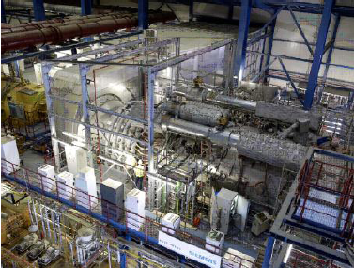
The ATAM-Phase 1
Step 3: Present Architecture
Must be presented at appropriate level of detail.
Usually not ‘perfect.’
Examples on next few slides:
Three online students’ MTS architectural solutions for analysis.

Slide 15
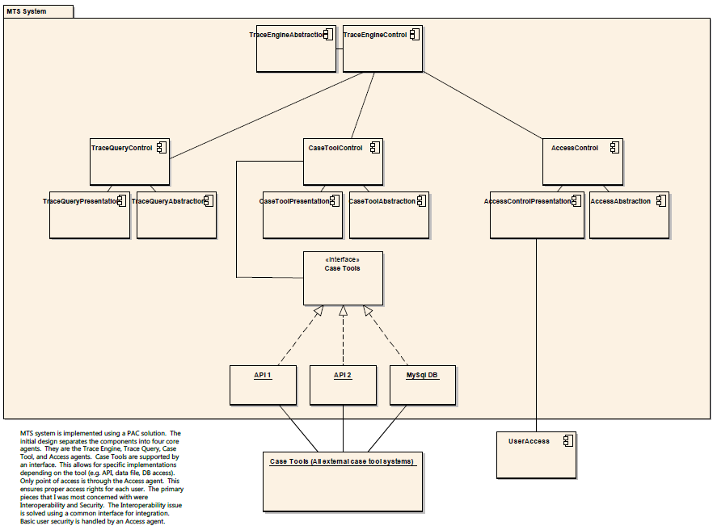
Example Solution 1: Presentation-Abstraction-Control
Notes:
The MTS system is implemented using a presentation–abstraction–control solution (architecture). The initial design separates the components into 4 core agents. They are the Trace Engine, the Trace Query, Case Tool, and Access agents. Case Tools are supported by an interface. This allows for specific implementations depending on the tool. Only point of access is through the Access agent. This ensures proper access rights for each user. The primary pieces that I (the student) was most concerned with were Interoperability and Security. The Interoperability issue is solved using a common interface for integration. Basic user security is handled by the Access agent.

Slide 16
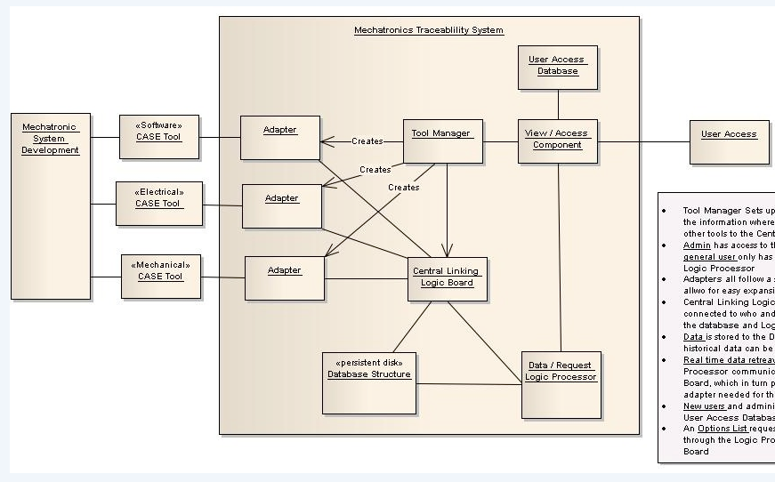
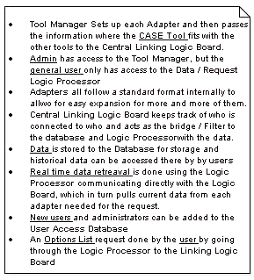
Example Solution 2: Adapters
Notes:
Tool Manager Sets up each Adapter and then passes the information where the CASE Tool fits with the other tools to the Central Linking Logic Board. Admin has access to the Tool Manager, but the general user only has access to the Data/Request Logic Processor. Adapters all follow a standard format internally to allow for easy expansion for more of them…

Slide 17
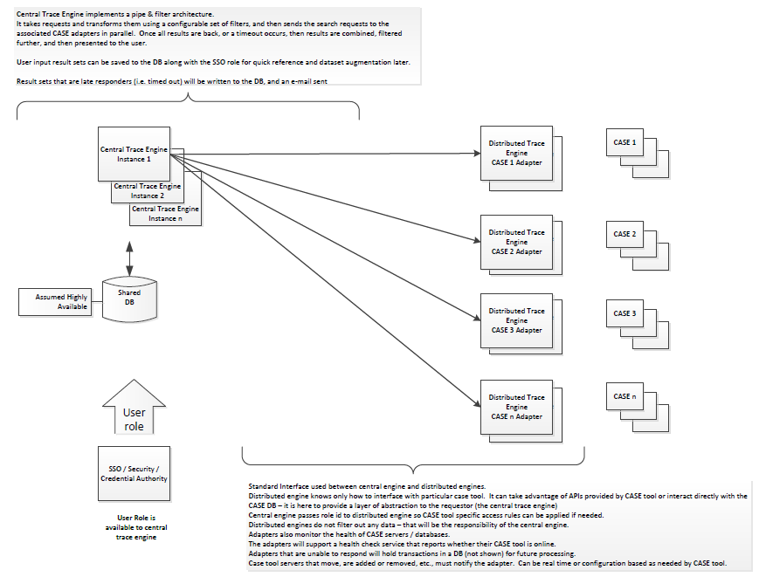
Example Solution 3: Pipe & Filter in the MIDDLE
Notes:
Central Trace Engine implements a pipe & filter architecture. It takes requests and transforms them using a configurable set of filters, and then sends the search requests to the associated CASE adapters in parallel. Once all results are back (or a timeout occurs) the results are combined, filtered further, and then presented to the user. User input results sets can be saved to the DB along with the SSO role for quick reference and dataset augmentation later.
Standard Interface used between central engine and distributed engines. Distributed engine knows only how to interface with a particular case tool. It can take advantage of APIs provided by CASE tool or interact directly with the CASE DB – it is where to provide a layer of abstraction to the requestor (central trace engine). Central engine passes role ID to distributed engine so CASE tool specific access rules can be applied if needed. Distributed engines do not filter out any data - that will be the responsibility of the central engine. Adapters also monitor the health of CASE servers/DBs. They will support a health check service that reports whether their CASE tool is online. Adapters that are unable to respond will hold transactions in a DB for future processing. Case tool servers that moved, are added/removed, etc. must notify the adapter. Can be real-time or configuration based as needed by CASE tool.

Slide 18
The ATAM-Phase 1
Step 4: Identify Architectural Approaches
Short step needed to catalog architectural approaches.
They were presented in the previous step; they are now just captured and documented.
Example from a healthcare system:
Layering, especially in OLTM (Online Transaction Manager).
Object orientation.
Use of configuration files to achieve modifiability without recoding or recompiling.
Client-server transaction processing.
A data-centric architectural pattern, with a large commercial database at its heart.
Articulate the approaches used in the design.

Slide 19
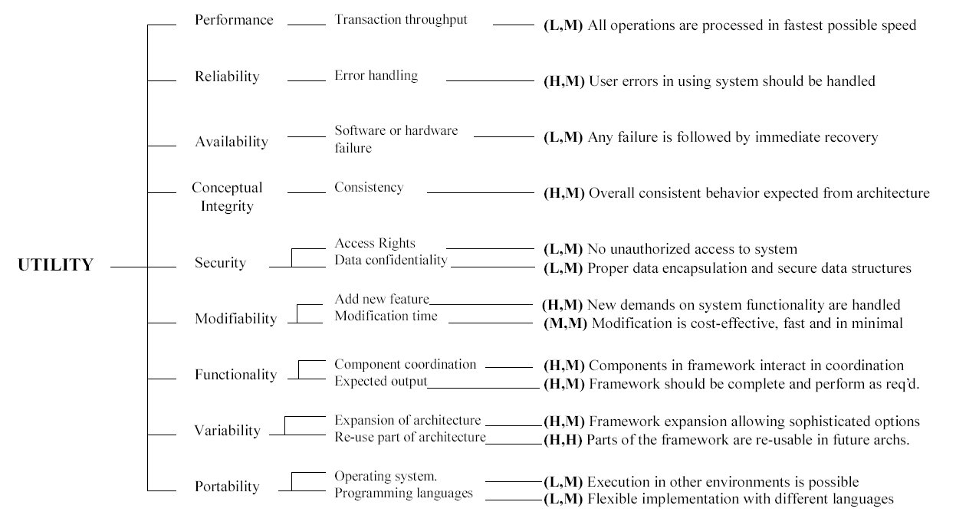
The ATAM-Phase 1
Step 5: Generate Utility Tree
All quality attributes identified in step 2 are included, and each one is refined.
(X,Y) X = Importance,
Y = Difficulty L = Low, M = Medium, H=High
Notes:
This is similar to how we rated requirements in the Attribute Driven Design method, only instead of rating them on (business value, architectural significance), we are rating them on (importance, difficulty).
This is because they are already all our architectural requirements.

Slide 20
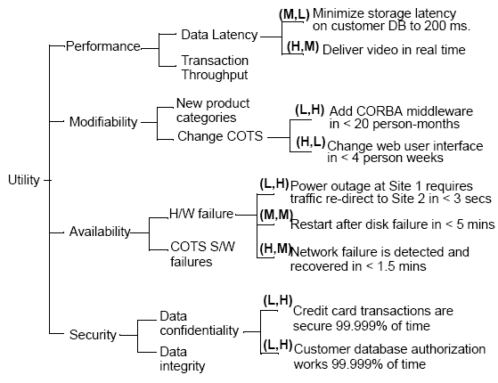
The ATAM-Phase 1
Another example…
All quality attributes identified in step 2 are included, and each one is refined.
(X,Y) X = Importance,
Y = Difficulty L = Low, M = Medium, H=High
Note that the leaf nodes (rated requirements in the last column) are measurable!
Notes:
Notice that the leaves (in the last column) measurable

Slide 21
The ATAM-Phase 1
Step 6: Analyze Architectural Approaches
Look for (H, H) and (H, M) scenarios and show how the architecture supports them.
Examples from Nightingale system:
Because Nightingale uses vendor-specific tools, components, and an SQL dialect not supported by or compatible with databases supplied by other vendors, replacing the database would be extremely difficult and expensive, requiring several staff-years of effort.
Because operating system dependencies have been localized or eliminated from OLTM and DSRGM, replacing the operating system with another one would require only a small modification.
Notes:
(x, y) = importance, difficulty
During this, the evaluation team documents the relevant architectural decisions and identifies and catalogs their risks, nonrisks, sensitivity points, and tradeoffs

Slide 22


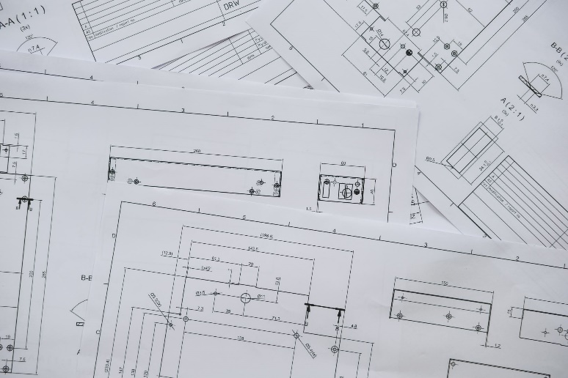
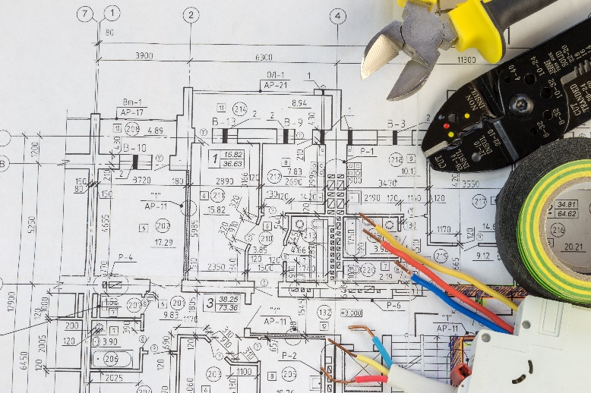
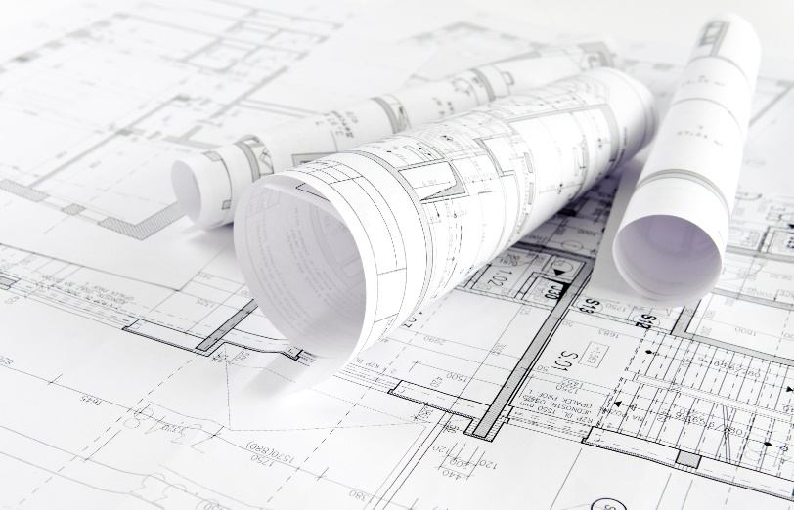

The ATAM-Phase 1
Step 6: Analyze Architectural Approaches
We are now done with Phase 1!
Notes:
(x, y) = importance, difficulty
During this, the evaluation team documents the relevant architectural decisions and identifies and catalogs their risks, nonrisks, sensitivity points, and tradeoffs

Slide 23
The ATAM-Phase 2
ATAM: Phase 2
Phase 2 commences after a couple of weeks in which previous findings are written up.
Attended by additional stakeholders.
Before beginning Phase 2, everyone is brought up to speed on a summary of the upcoming method steps and results so far.
Includes the following steps:
Brainstorm and prioritize scenarios.
Analyze architectural approaches.
Present results.
Notes:
“To use an analogy from programming: Phase 1 is akin to
when you test your own program, using your own criteria. Phase 2 is when you
give your program to an independent quality assurance group, who will likely
subject your program to a wider variety of tests and environments.”

Slide 24
The ATAM-Phase 2
Step 7: Brainstorm and Prioritize
A larger group of stakeholders brainstorms scenarios that are operationally meaningful with respect to their roles. Scenarios may include ones in the utility tree, but may also include additional ones.
Purpose is to make sure architecture vision aligns with stakeholders’ expectations.
Prioritized using a voting scheme.
Examples:
Previously public data is made private, & access is adjusted accordingly.
Data in the information hub is replicated to a branch clinic, and performance is degraded.
High priority scenarios are added to the utility tree wherever feasible.
Notes:
Understand what does success mean for the stakeholders?
Common voting scheme is to give each stakeholder a limited # of votes to allocate to whichever scenarios they want.
If the scenarios are the same as those already in the utility tree, it indicates good alignment between what the architect had in mind and what the stakeholders actually wanted.
Big discrepancies, are therefore, a potential risk, as they indicate disagreement between what is important.

Slide 25
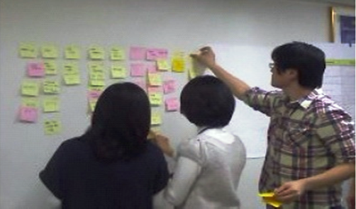
The ATAM-Phase 2
Step 8: Analyze Architectural Approaches
Demonstrate how the architecture (and architectural decisions) provide support for the highest-prioritized scenarios.
Repetition of Step 6 with the new scenarios.
Notes:
Typically covers top 5-10 scenarios. # of scenarios covered usually limited by time constraint.

Slide 26
The ATAM-Phase 2
Step 9: Present Results
Documented architectural approaches.
Set of scenarios and the prioritization from the brainstorming
Utility tree
Risks discovered (grouped into risk themes)
Nonrisks documented
Sensitivity points and tradeoff points found

Slide 27
Class Activity
MTS Exercise
Step 1: Discuss the MTS requirements on slide 12.
Do we have sufficient requirements? (if not, add 1-2 requirements)
Do we understand them? (if not, modify the existing requirements)
Step 2: What are the business drivers? List 3-4.
Step 3: What are the architectural approaches used in each of the 3 designs? (slides 15-17)
What drivers do they satisfy? (List drivers satisfied for each)
Step 4: Create a utility tree for the MTS requirements (examples on slides 19 and 20)
Notes:
Step 1: Discuss the MTS requirements on slide 12.
Do we have sufficient requirements?
Do we understand them?
Step 2: What are the business drivers?
Step 3: What are the architectural approaches used in each of the 3 designs? (slides 15-17)
What drivers do they satisfy?
Step 4: Create a utility tree for MTS (examples on slides 19 and 20)

